Slide 1

OOPS USING JAVA
COURSE BASED PROJECT
PROJECT NAME –UNIVERSITY MANAGEMENT SYSTEM
SEM-II (SESSION – 2024-2025)
TEAM MEMBERS :-
ASHISH PRATAP(24SCSE1410316)
SONALI BHATI (24SCSE1410352)
GARIMA RAJPUT(24SCSE1410138)
ANANYA YADAV(24SCSCE1410024)

Slide 2
INTRODUCTION
  A university is a place where students acquire knowledge, develop skills, and shape their futures. It includes numerous departments, faculties, and administrative units that work together to ensure smooth academic and non-academic operations.
  Managing university-related activities like student admissions, course registrations, fee payments, examination records, faculty management, and scheduling can be highly complex and time-consuming if done manually.
  With the growing number of students and staff, efficient handling of academic and administrative operations is essential. A University Management System ensures proper organization and accessibility of data, which helps in making better decisions and delivering enhanced services.
  t enables the university administration to automate and streamline all major operations, including student enrollment, attendance management, academic performance tracking, and resource allocation.
  Considering the growing demand for digitization in the education sector, a comprehensive University Management System becomes a necessity. It reduces paperwork, minimizes errors, saves time, and improves overall efficiency.

Slide 3
PROBLEM STATEMENT
The University Management System aims to digitize and simplify the various administrative and academic processes within a university. Currently, many universities still rely on manual methods for managing student records, faculty data, admissions, course registrations, and exam schedules, which leads to inefficiencies and increased chances of error.
The system is designed to assist university administrators, faculty, and students by providing a centralized platform where data can be stored, accessed, and managed with ease. It helps administrators manage student enrollments, maintain attendance records, assign courses, track academic progress, and handle fee transactions efficiently.
Faculty members can use the system to update grades, manage timetables, and communicate with students. Students benefit by being able to register for courses, check their attendance, view results, and get important notifications.

Slide 4
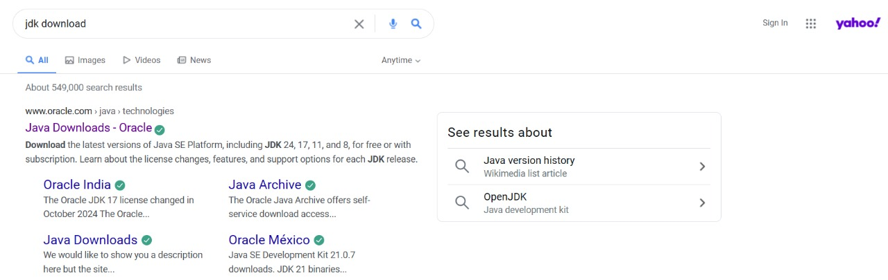
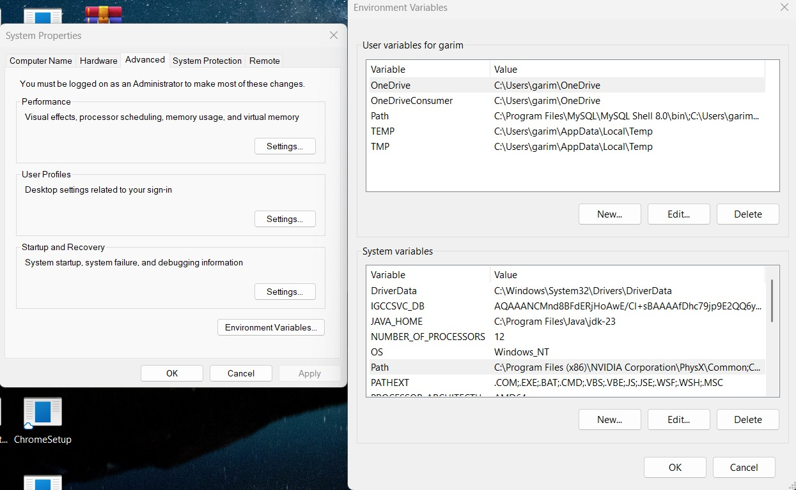
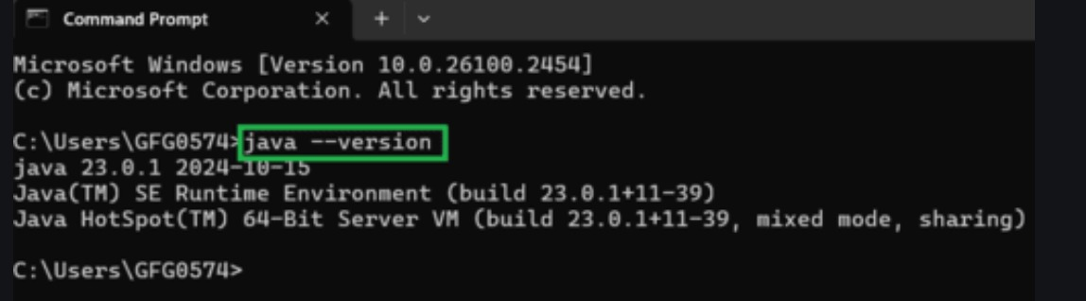
INSTALL JDK

Slide 5
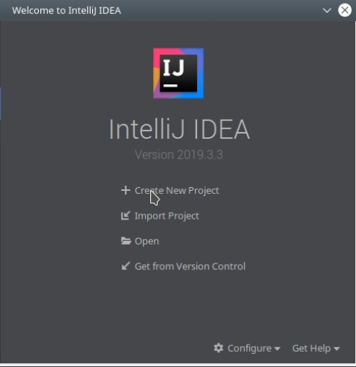

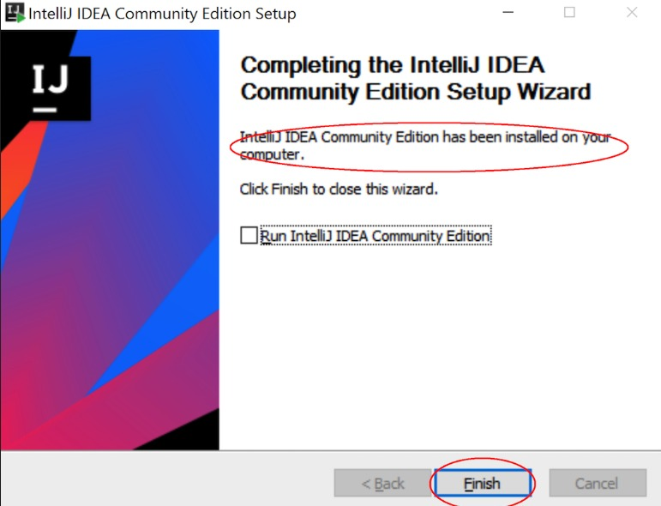
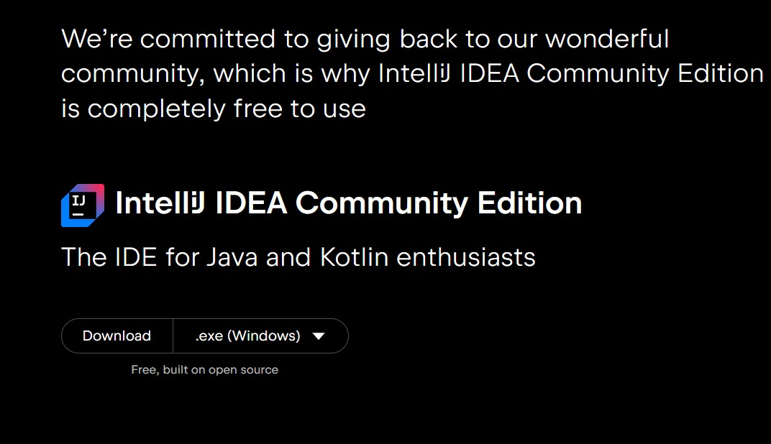
INSTALL IDE (INTELLIJ IDEA)

Slide 6
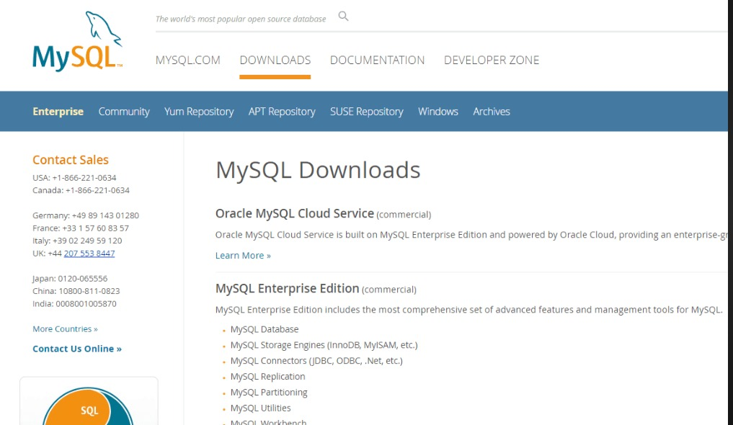
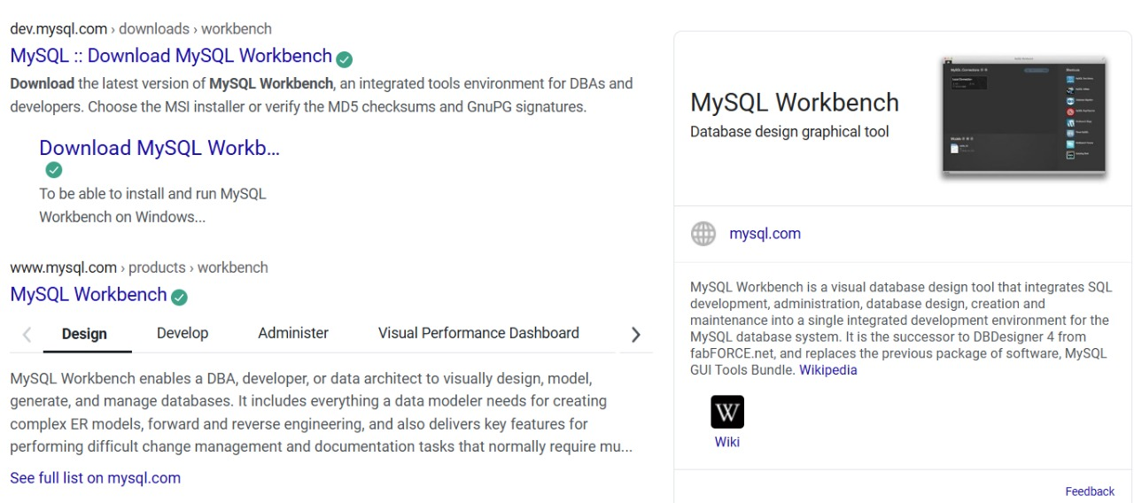
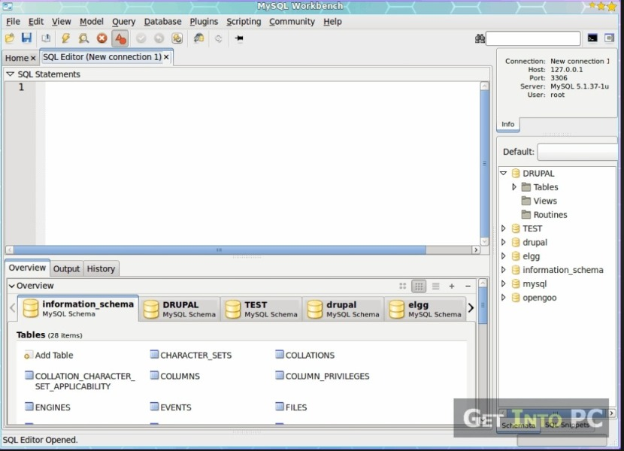
INSTALL MYSQL

Slide 7
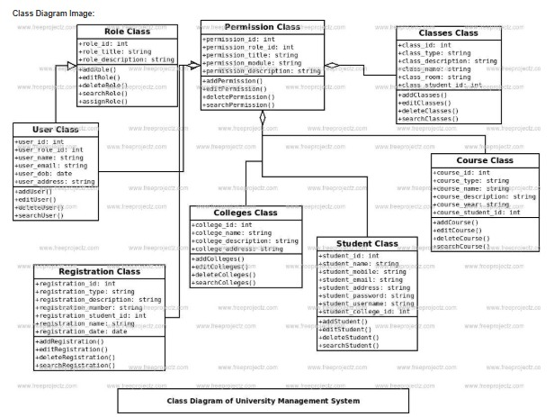
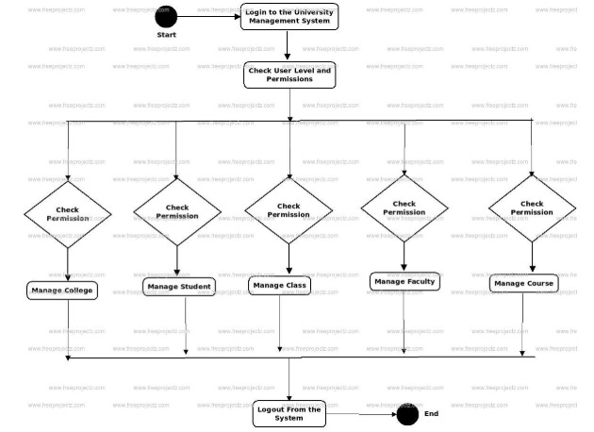
PROJECT STRUCTURE
CLASS DIAGRAM

Slide 8
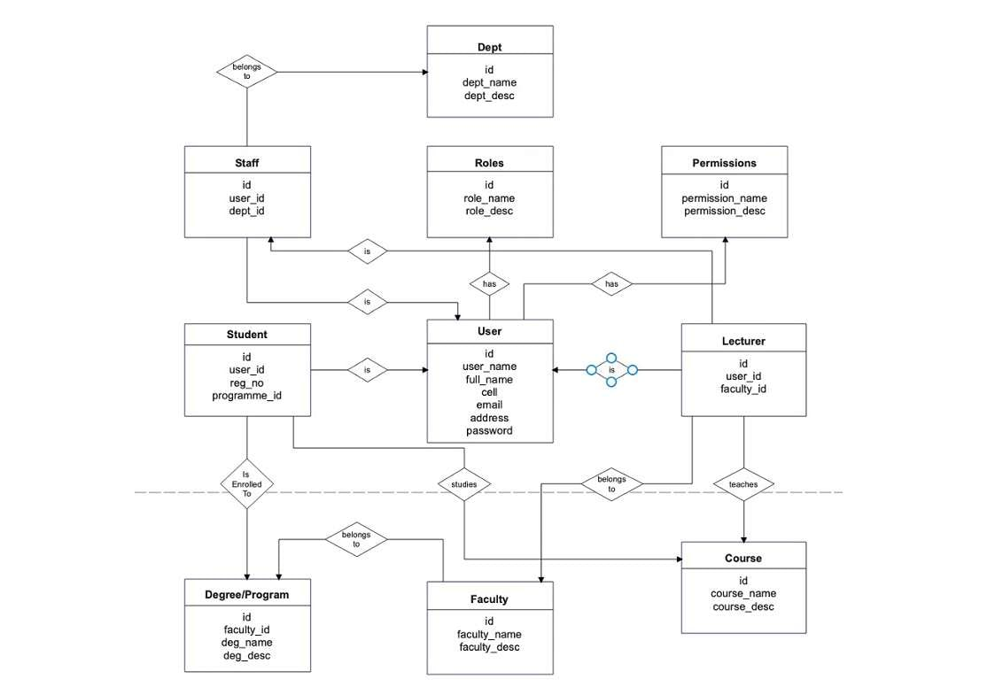
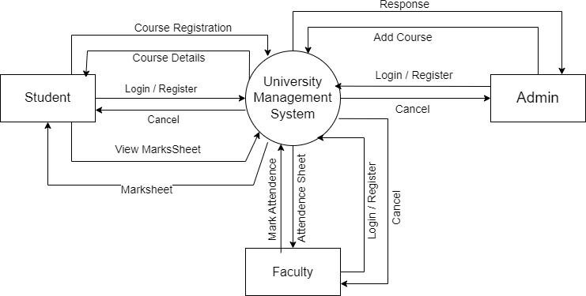
PROJECT STRUCTURE
ER DIADRAM

Slide 9
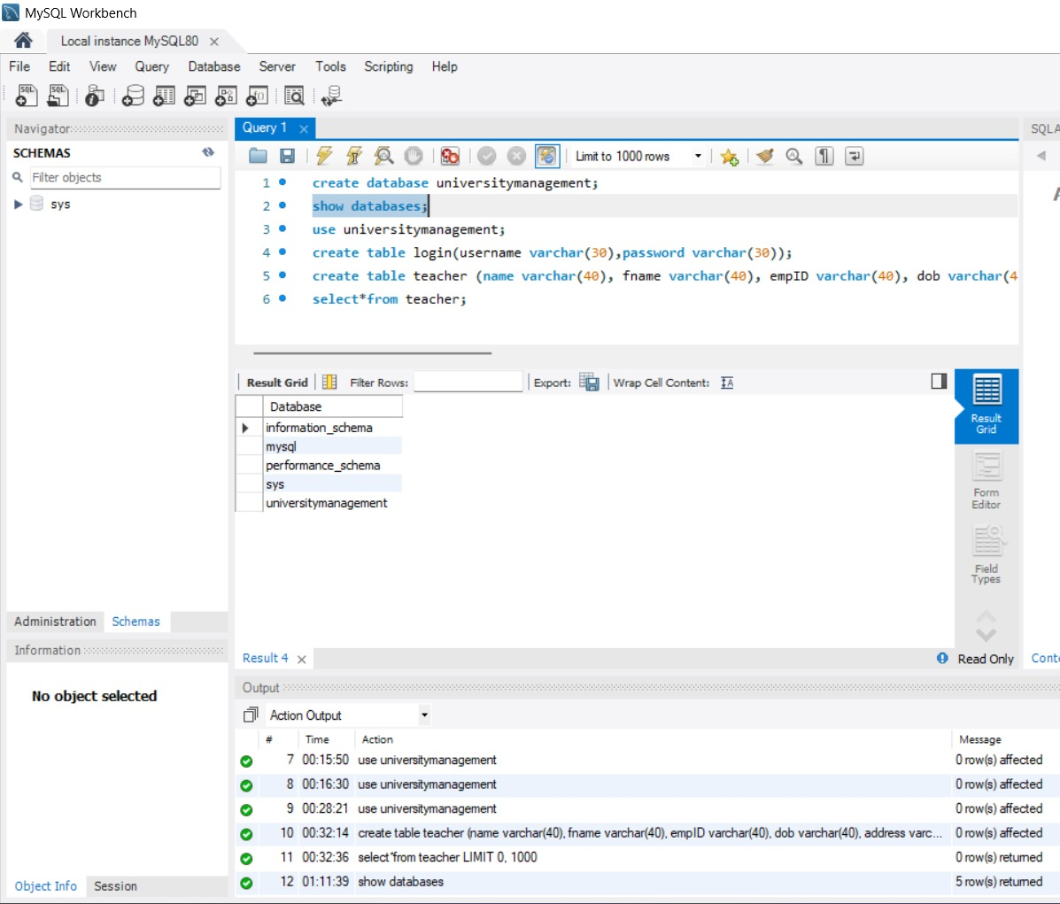
DEGSIGN THE DATABASE SCHEMA FOR THE PROJECT
📘 University Management Database Schema –
The University Management Database Schema is designed to comprehensively manage academic, administrative, and operational processes of a university. This relational schema ensures efficient handling of students, faculty, courses, departments, exams, and other key components within a university ecosystem.

Slide 10
IMPLEMENT JDBC FOR DATABASE CONECTIVITY
Class.forName("com.mysql.cj.jdbc.Driver");
connection = DriverManager.getConnection("jdbc:mysql:/// universitymanagementsystem","root","MyCode@123");
statement = connection.createStatement();

Slide 11
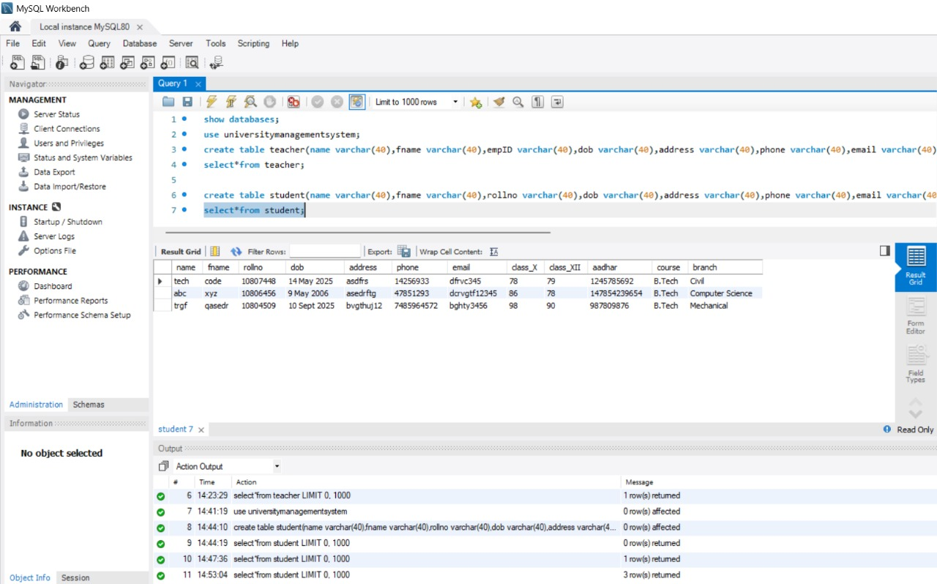
CREATE MY MYSQL TABLE
MySQL tables are crucial as the project relies on structured data for seamless operation—handling everything from course registrations to student records. This University Management System implicitly creates tables that manage students, faculty, courses, departments, and enrollment data, ensuring all queries execute correctly without manual table creation.

Slide 12
MODEL AND DAO CLASSES FOR DATABASE
Model Classes
Model classes represent the structure of the data used in the system. Each model corresponds to a real-world entity such as Student, Faculty, Course, or Department.
Key Features of Model Classes:
Encapsulate the attributes (fields) of an entity, provide getters and setters for data access and modification, support object creation to transfer and store data, example: A Student model contains fields like id, name, email, department, and year.
DAO (Data Access Object):
ClassesDAO classes handle all interactions with the database. Each DAO corresponds to a model and performs CRUD operations (Create, Read, Update, Delete).

Slide 13
Responsibilities of DAO Classes:
Connect to the database ,execute SQL queries safely using prepared statements,, return model objects after fetching data, Isolate database logic from the UI and business layers
Advantages:
Promotes code reusability and modularity, makes it easier to switch databases (e.g., from MySQL to PostgreSQL).Enhances security through use of parameterized queries (prevents SQL injection).Example: A StudentDAO class contains methods like:
addstudent(student student)
getstudentBYID(int id)
Updatestudent(int id)
getAllstudent()

Slide 14
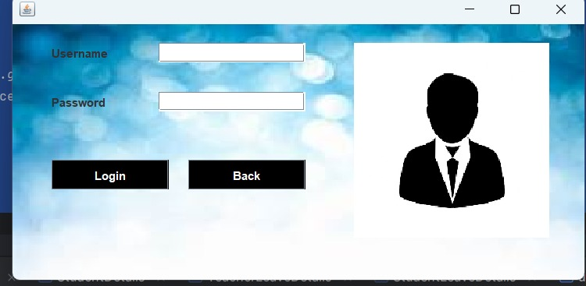
AESTHETICS AND VISUAL APPEAL OF THE UL
Background Layout :
Applied full sized images of university and coloured background with suitable colour combinations, with outcoming images for 7 seconds transition.
Text Styling :
Fonts are styled ,the headings are styled with bold, coloured that make it more realistic and official.
Buttons Design :
Functioning buttons are applied with their assigned work ,In the first interface of the project the Login and Back are created for logging ,back.
Color contrast :
The white and black text are created according to their proper and attractive visibility.

Slide 15
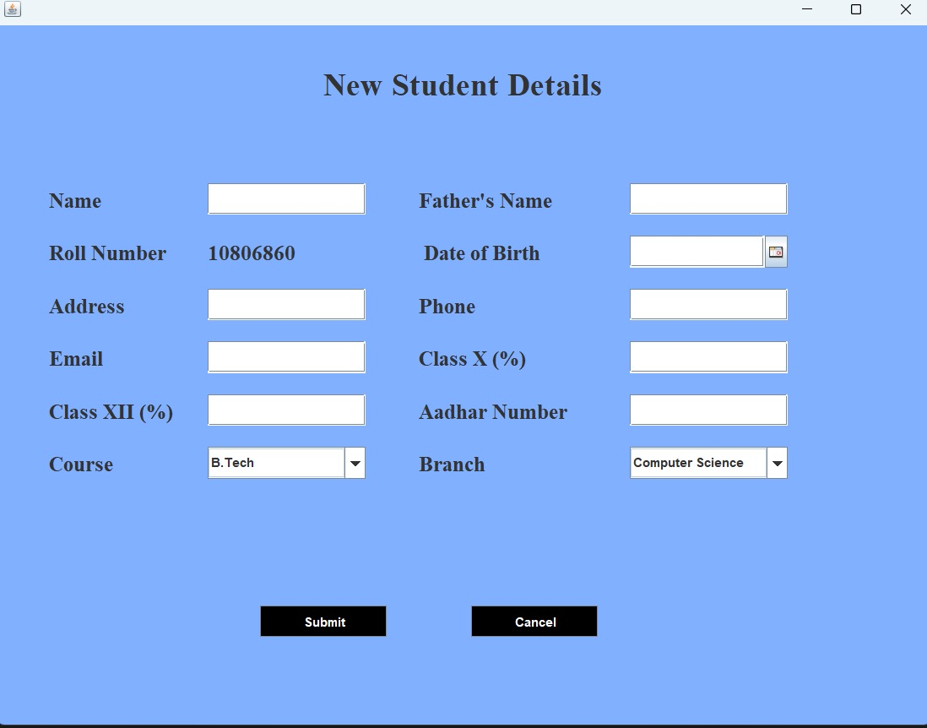
COMPONENTS PLACEMENT AND ALIGNMENT IN THE UI
Logical Grouping:
In the University Management System, related elements such as Student Name, Roll Number, Department, and Email are grouped logically under Student Registration, while Course Code, Title, and Credits are grouped under Course Management. This ensures clarity and intuitive navigation.
Clear Label-Input Association:
Each label (e.g., "Student ID", "Course Name") is placed immediately to the left or above its corresponding input field. This consistent association helps users understand the purpose of each field at a glance.

Slide 16
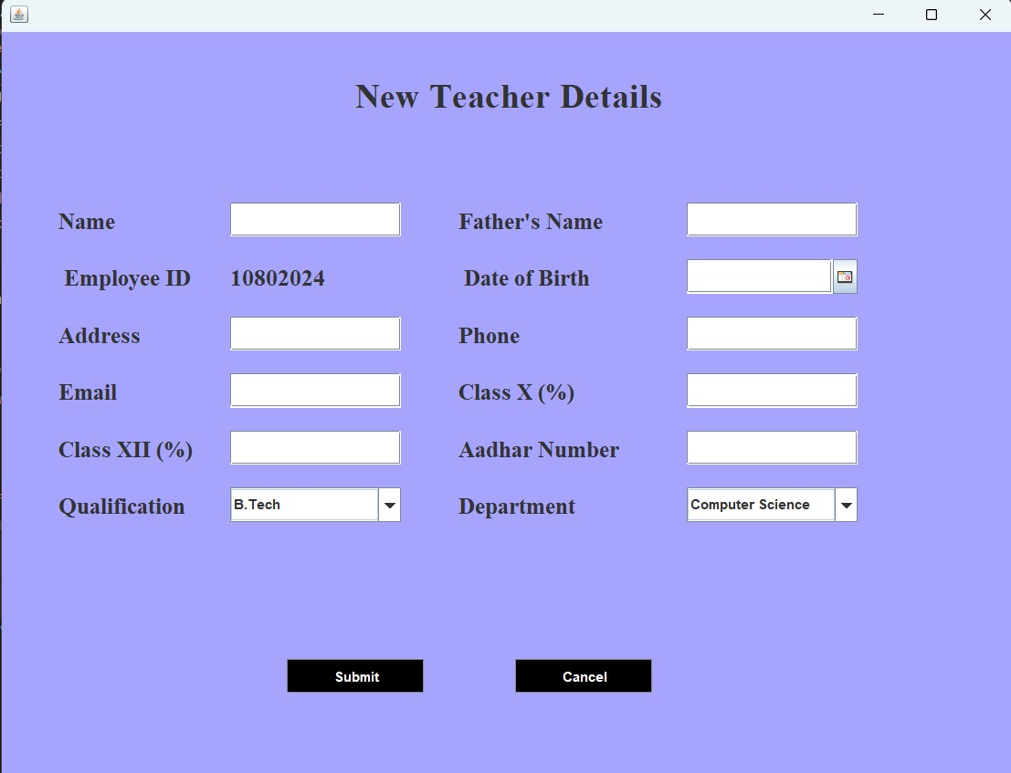
Button Placement:
Key action buttons like Submit, Update, Reset, and Delete are aligned horizontally at the bottom of each form. Their placement is consistent across modules, improving usability and minimizing user confusion.
Consistent Margins and Padding:
All input fields, labels, and buttons maintain uniform spacing and padding to create a clean, structured layout. This alignment provides a professional look and makes the UI visually balanced within the application window.

Slide 17
RESPONSIVENESS AND ACCESSIBILITY OF THE UI
Adaptive Layout:
Responsive design adjusts to desktops, laptops, and tablets, Layout managers ensure flexible and resizable components.
Scrollable & Dynamic Views:
JScrollPane and tables for large datasets (students, courses),HTML-formatted labels for clarity and adaptability.
Logical UI Structure:
Top-down layout flow for intuitive navigation, Grouped modules (Admissions, Exams, Attendance) with clear forms.
Accessibility Features:
High contrast (black on white).Keyboard navigable & screen reader friendly.
Readable Fonts & Hierarchy:
Legible fonts (Segoe UI, Arial).Bold and size variation for headings and emphasis.
Feedback & Error Handling:
Real-time input validation, Descriptive error messages near fields.

